Slide 1

Object Oriented Design & Programming (21CSC101T)
Arvind Kharwal

Slide 2
Structure of C++ Program

Slide 3
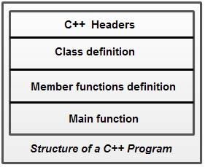

Slide 4
Thank You

